Slide 1


Mobile APP for IIT
Shadman Sakib
Roll : 181909
Batch: MIT-19
IIT, DU

Slide 2
Objective
Develop a Server Side admin Panel
Develop the capabilities of admin panel to view and manage batch course, lesson, notices.
Develop a system which would centralize all the course material used by the course for the previous batches
Develop a mobile application to integrate the course and notice management.

Slide 3
Features
Admin
Admin Login
Batch Add/Update
Manage Student
Manage Course
Manage Notice
Mobile
Student Login
Manage Course material
Manage Academic activities
Customized and Shareable To-do Items

Slide 4
Technology Used
Server End
.net core 3.0. c#, javascript, html and css.
Client side blazor application.
Deployment on popular server OS including windows, linux and mac.
Docker Support
Mobile
Xamarin Forms (Android 5.0+ and iOS 8.0+)
C#
MVVM

Slide 5
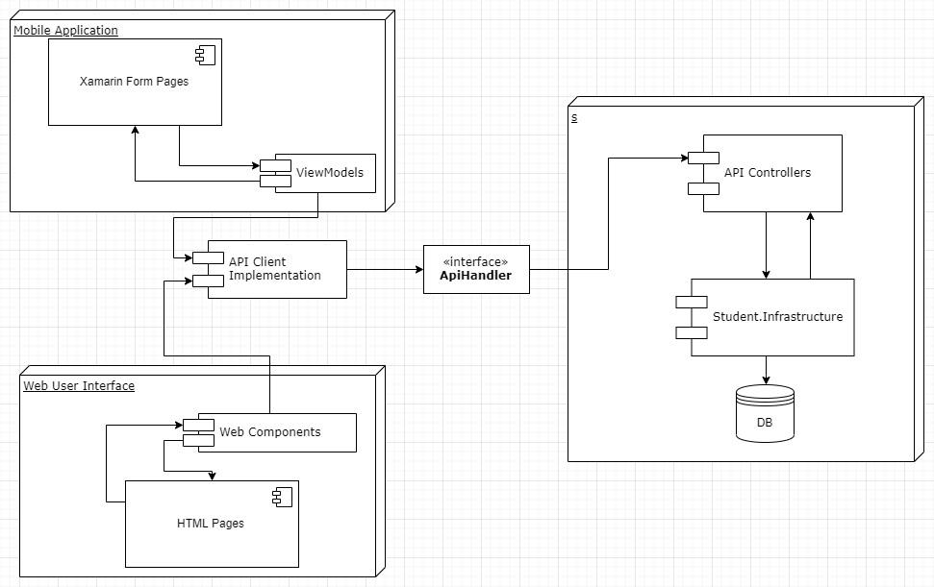
Data Flow Diagram

Slide 6
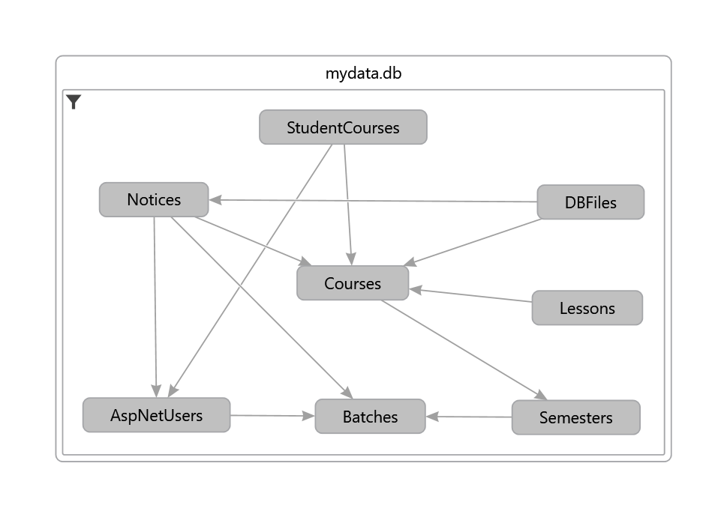
Entity Relation Diagram

